Slide 1
ICANN Update
APStar Retreat | 21 Feb 2016
Jia-Rong Low, VP Asia, & MD APAC Hub
ICANN

Slide 2



2016 – A Year of Transitions

Slide 3

Transition - CEO
Göran Marby
DG, Swedish Post & Telecom

Slide 4

Transition - CEO
Göran Marby
DG, Swedish Post & Telecom

Slide 5
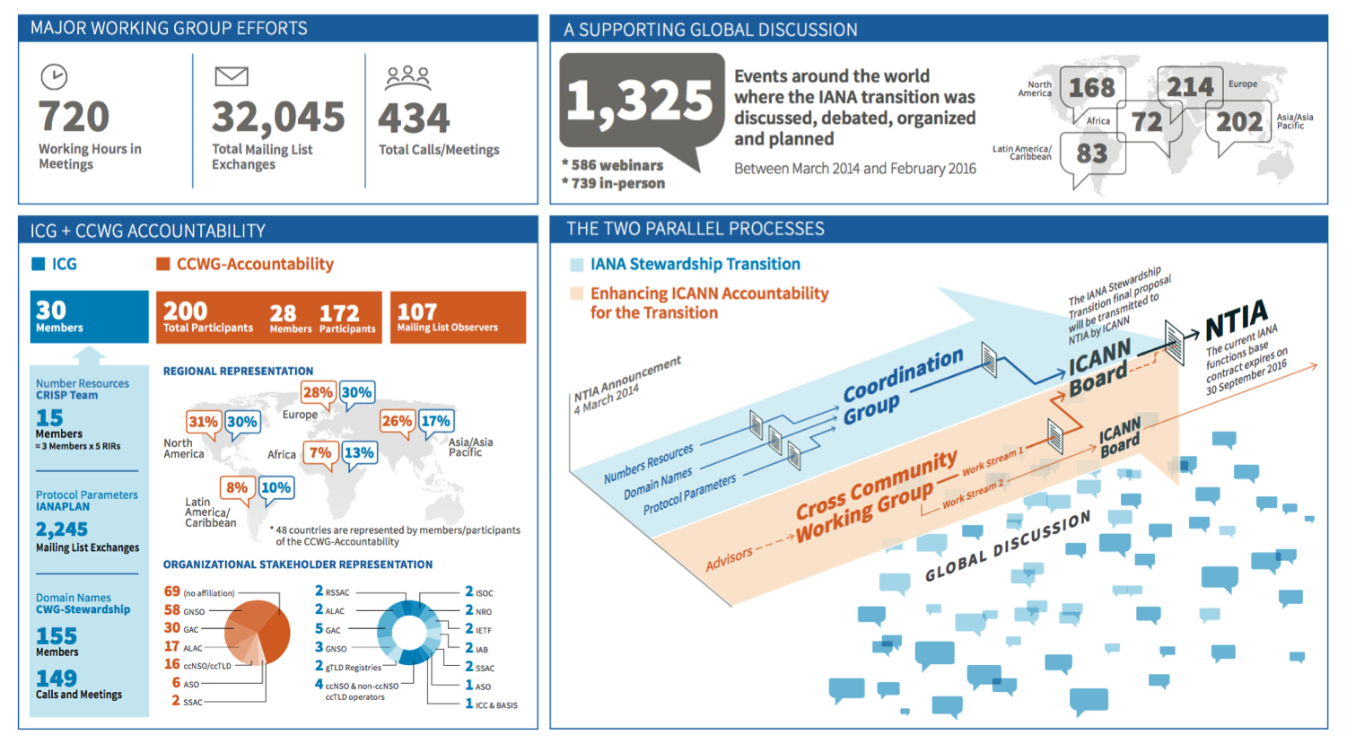
ICANN55 – IANA Transition a key priority

Slide 6
APAC Hub

Slide 7
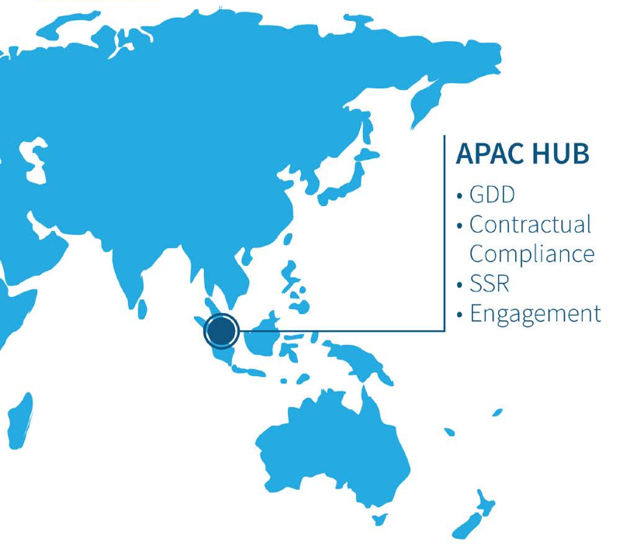

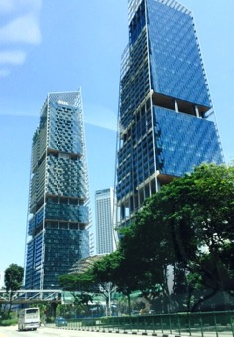
Globalization remains a priority
“Evolve and further internationalize and regionalize ICANN’s implementation of the multistakeholder approach”
ICANN’S efforts in Globalization
APAC Hub

Slide 8

Globalizing APAC Functions – Further Streamline
Registry / Registrar Services
Contractual Compliance
Stakeholder Engagement
APAC Hub
Customer Service Support
Supporting Functions

Slide 9
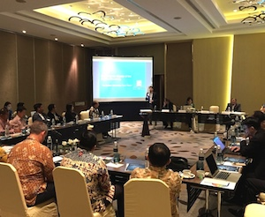
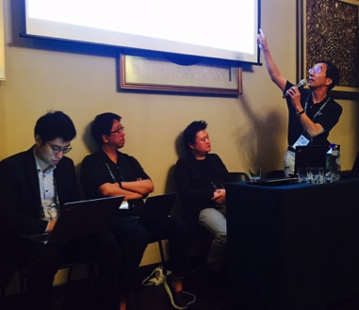
Facilitate for region to participate in ICANN globally
Bringing ICANN issues to you
Local context and language
Next Generation “WHOIS”
New gTLD programme reviews (Consumer,Trust and Choice, Root Stability, DNS Abuse)
Rights Protection Mechanisms
RDAP Operational Profile Public Comment
Content localisation (MOU with Japan and Thai community)
Local and regional ICANN read-outs
Facilitate dev. of MS approach
Internationalised Domain Names (IDN) programme
Support regional IG events

Slide 10








Engage with ICANN
Thank You and Questions
Reach us at:
Email: apachub@icann.org
Website: icann.org
twitter.com/icann
gplus.to/icann
facebook.com/icannorg
weibo.com/ICANNorg
linkedin.com/company/icann
flickr.com/photos/icann
youtube.com/user/icannnews
slideshare.net/icannpresentations

